Slide 1
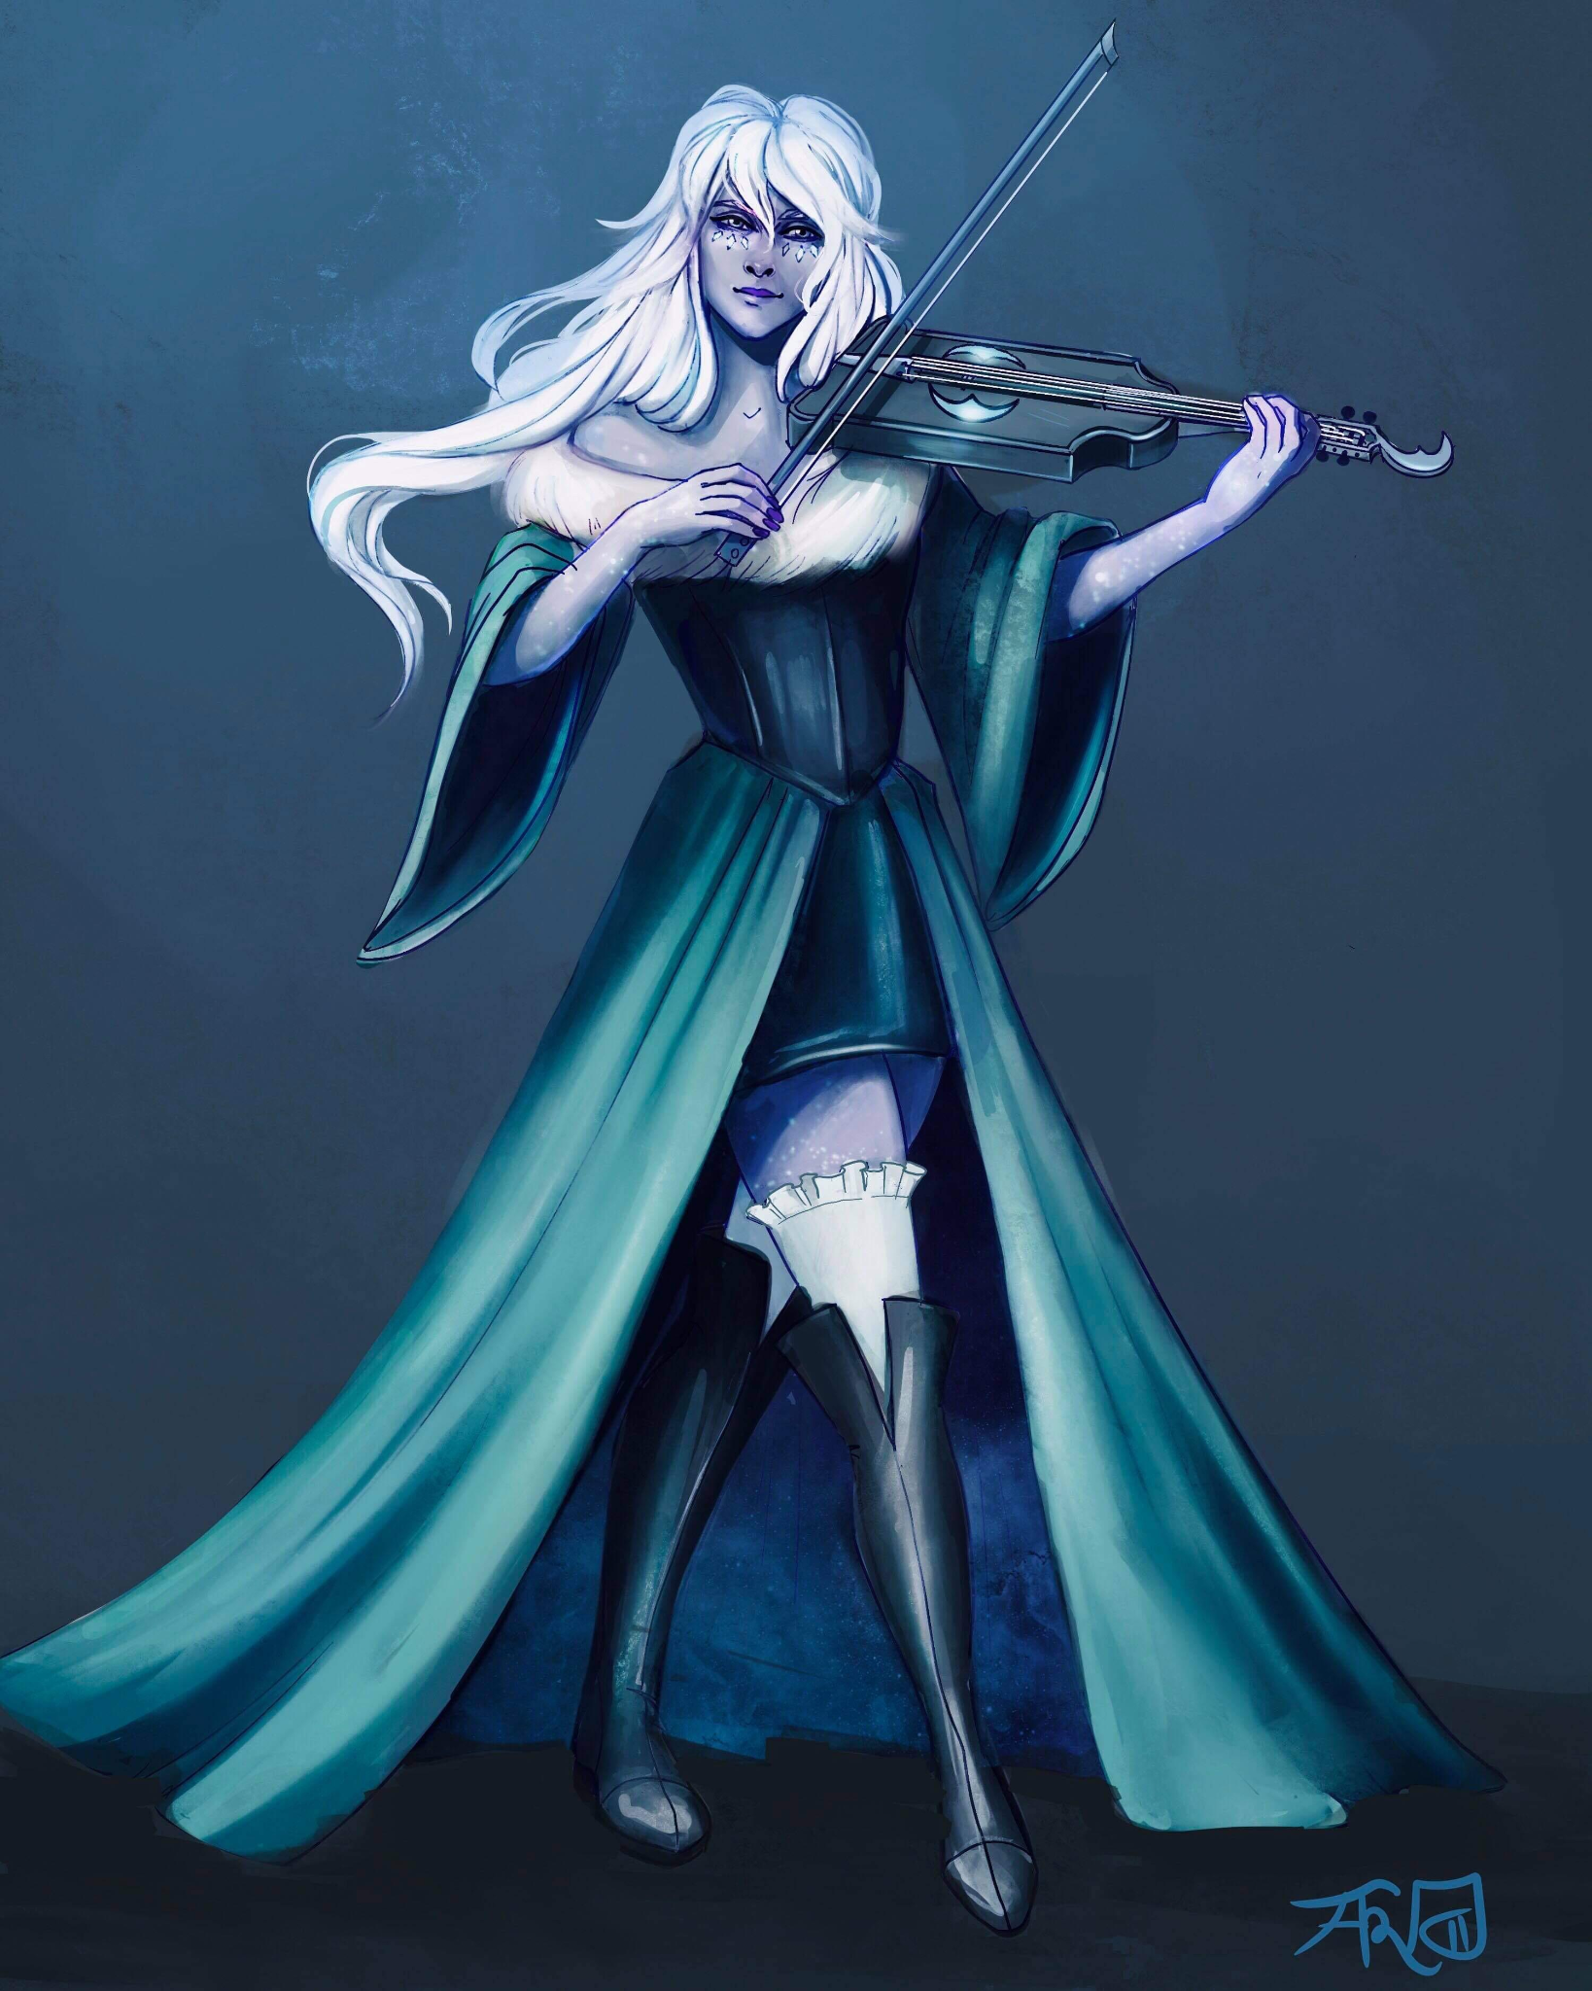
Bethany de Bolbec
Half Elf
Assistant at the Day Dream Library
Loves to play Viola and wants to prove her worth by joining the Flatcoat Circus.
Currently in a relationship with Desparia.

Slide 2
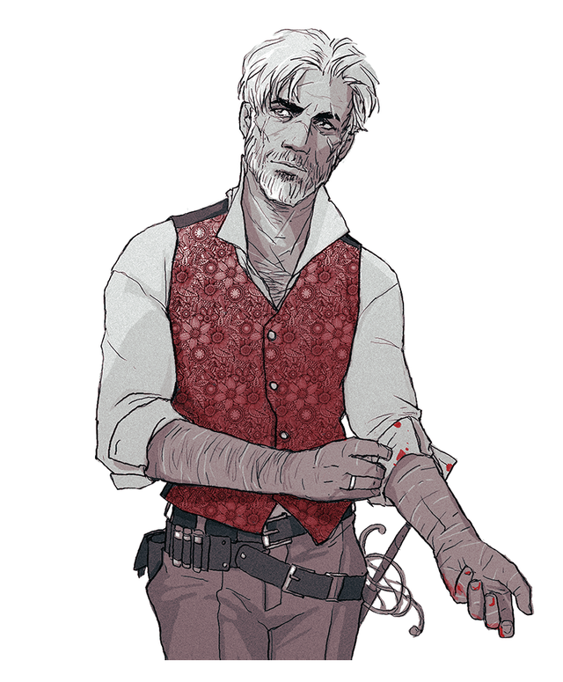
Penguin Lyonsbane (Varaati)
Half-Elf
Adopted brother of Rhino’s Family
Currently with the party as a member of the Order of the Orb.
Has some sort of curse within himself from Hadaar.
Discovered from the eyes of Aboccoba that his true last name in Lyonsbane

Slide 3
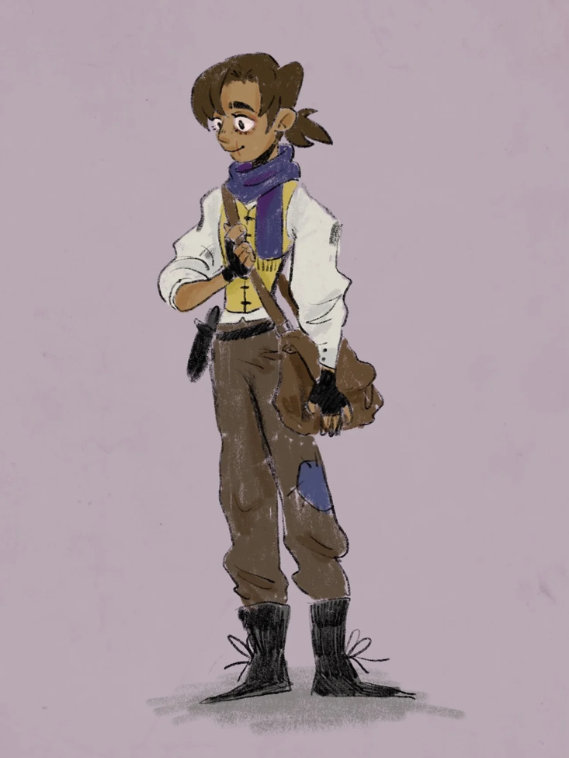
Kyle
Human
Beat Rhino in Arm Wrestling due to the help of the party.
Has Third Degree Burns on his right arm to his right eye.

Slide 4
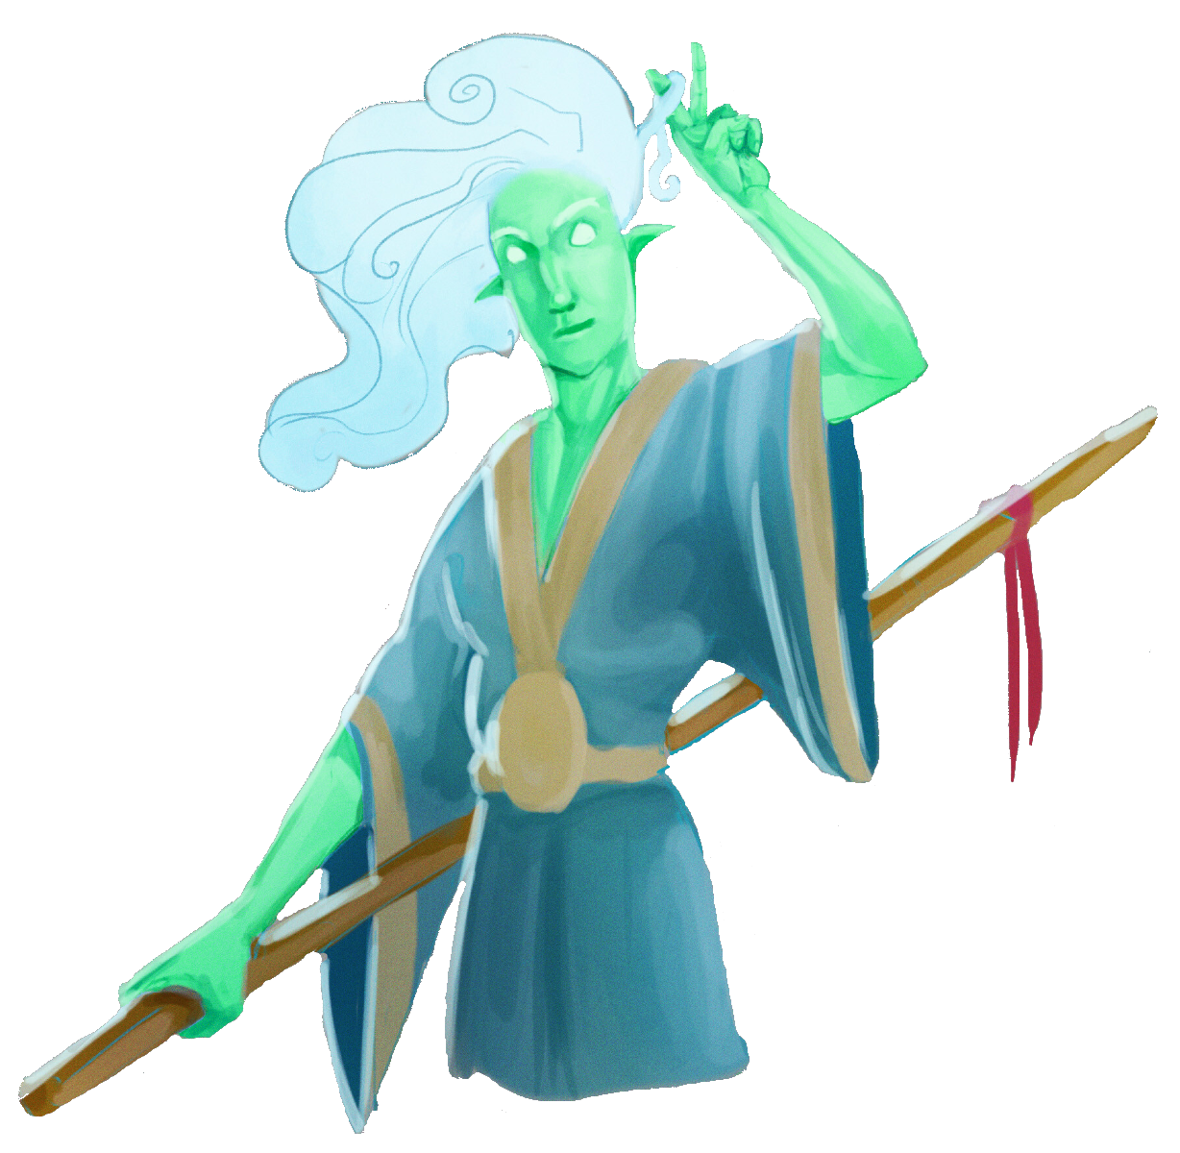
Whistle
Wind Genasi
Met at the White Basin Hotel in Helmfield
Adventuring with Marble
Fought off Rampaging Rhino.

Slide 5
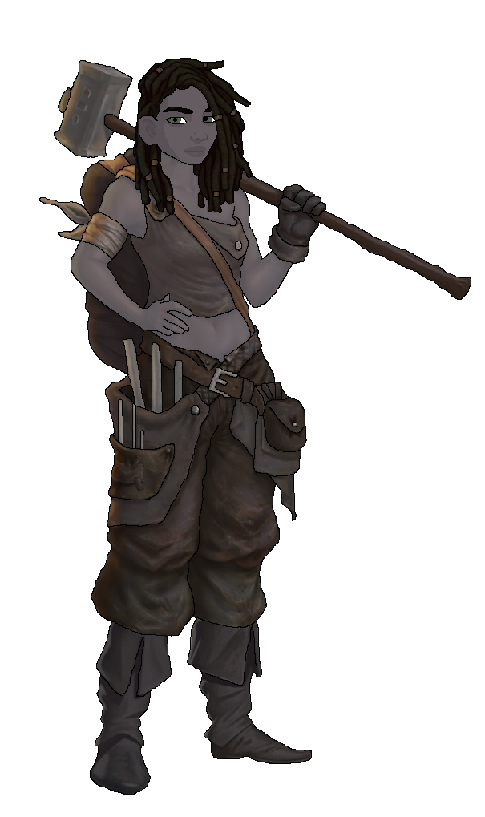
Marble
Earth Genasi
Met at the White Basin Hotel in Helmfield
Adventuring with Whistle
Fought off Rampaging Rhino.

Slide 6
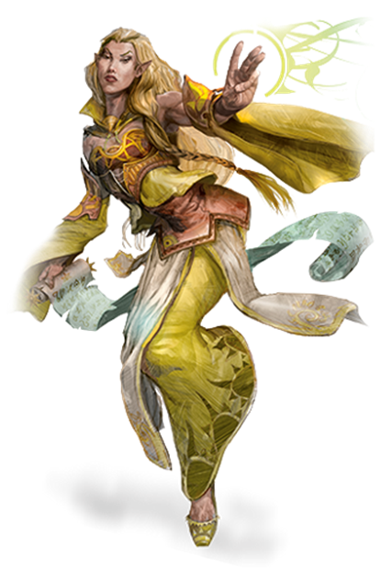
Ramona Moonbirth
Elf
Met as a traveling adventurer in Helmfield
Owns the magic shop, the Twinkling Emporium in Shesmont
Extremely interested in any ancient artifact

Slide 7
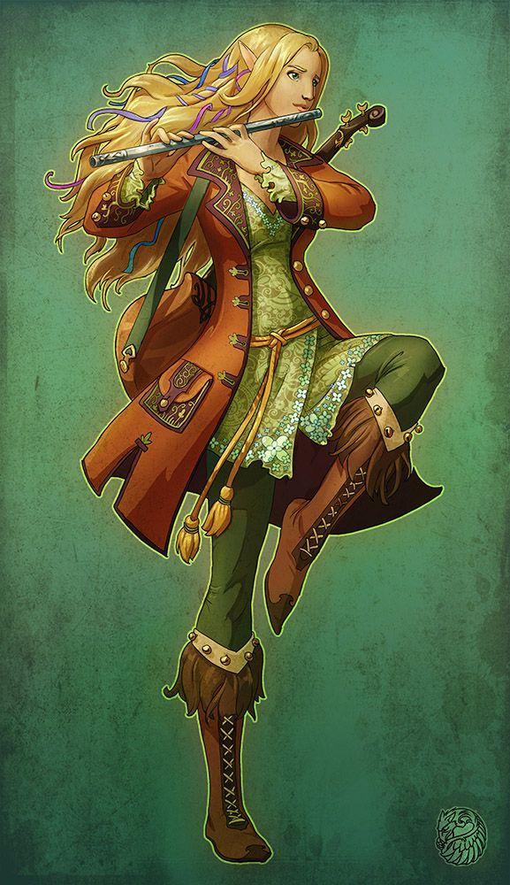
Antigua Dankil
Elf
Likes to be called Anti.
Loving adopted mother of Wyrin.
Gave the “Dormant Requiem” to Wyrin.

Slide 8
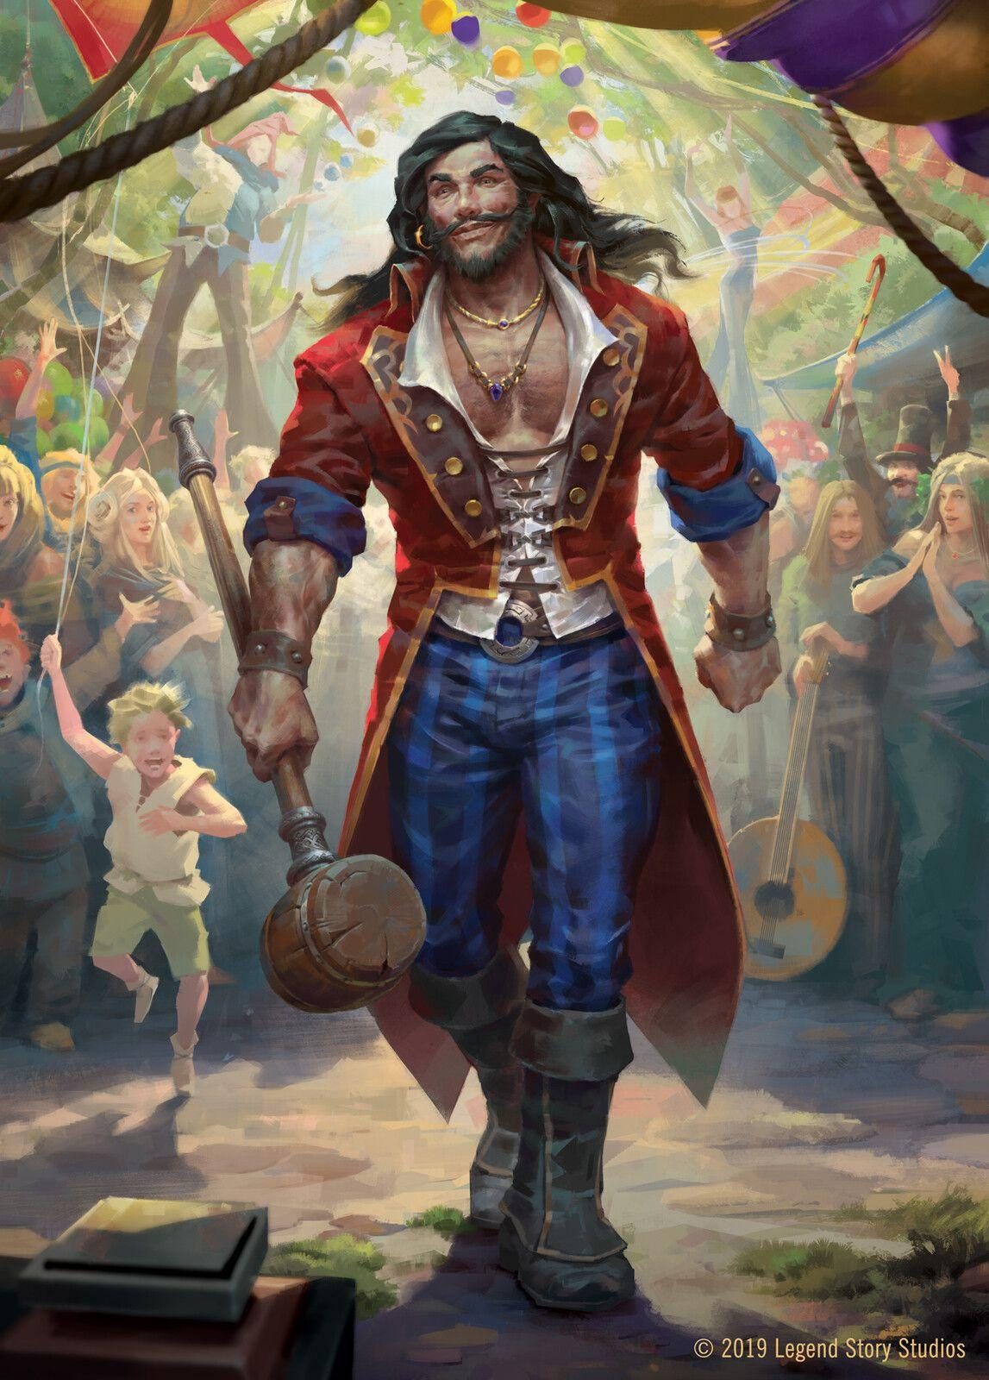
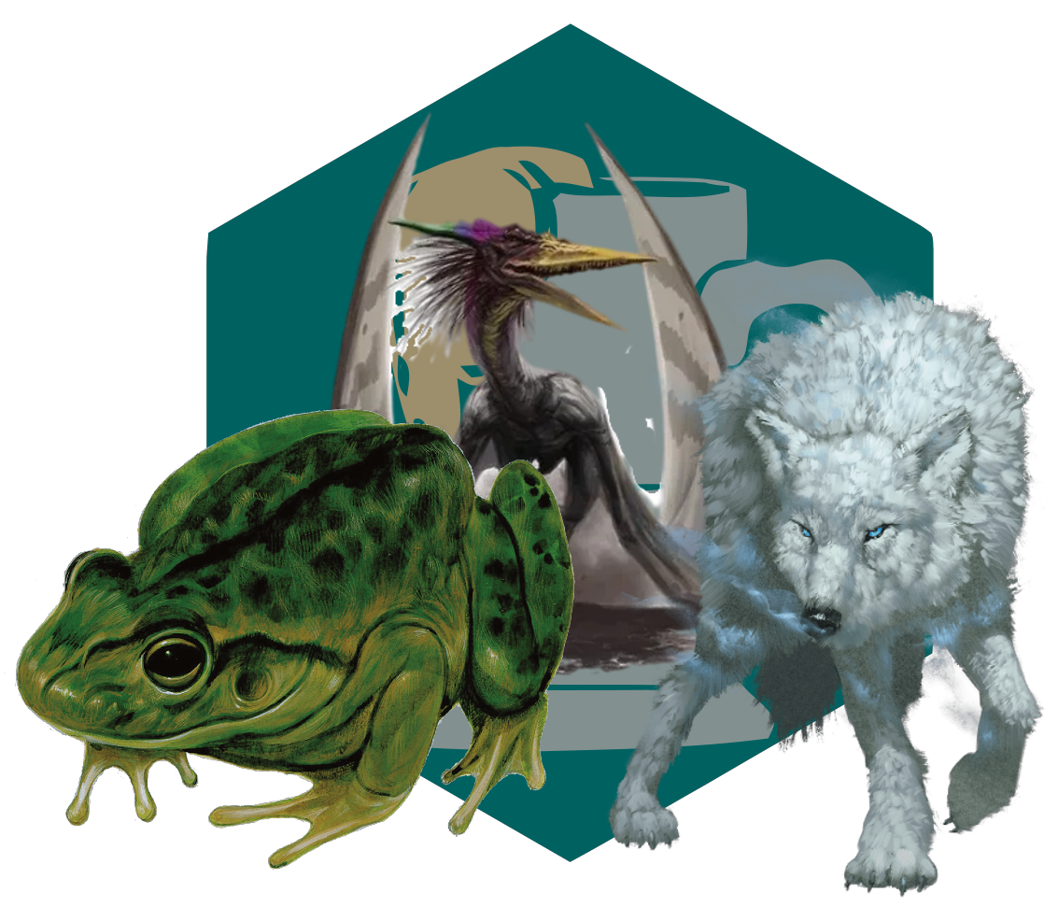
Adrik Dankil
Human
Loving adopted father of Wyrin.
Owns a Wolf named Bear, Giant Frog named Bertha and a Pteranodon named Floop.

Slide 9
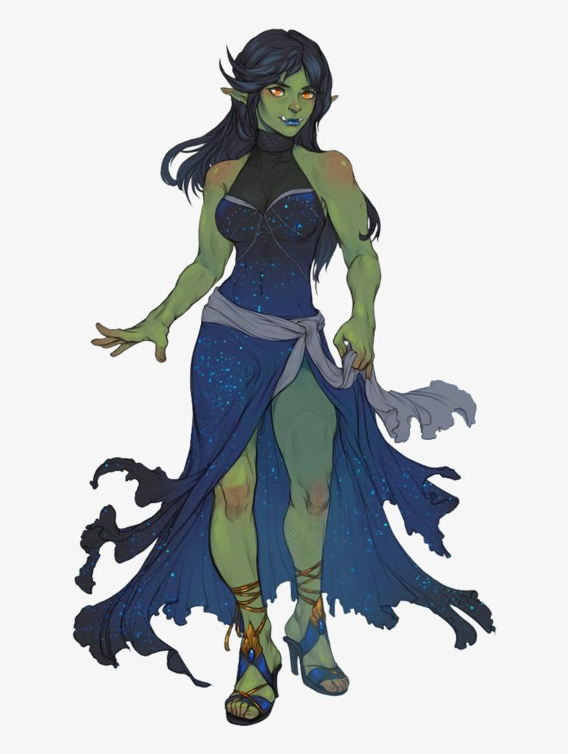
Myev
Half Orc
Loving sister of Wyrin who protects her from bullies.
Has a love for pyrotechnics
Helped the party with the initial dive into the Castle in Basinhold.

Slide 10
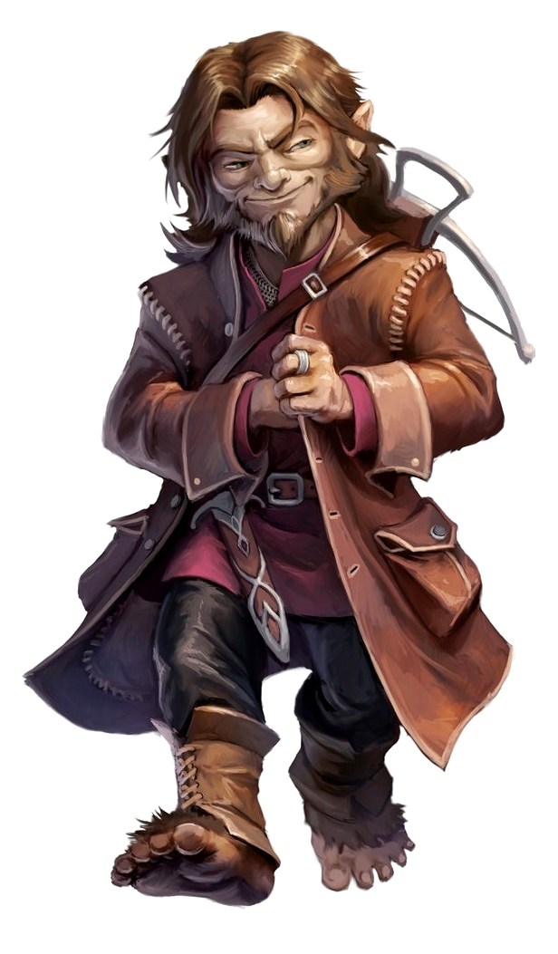
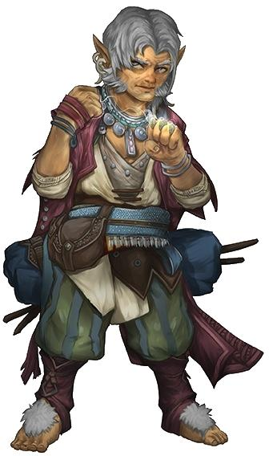
Ander High-Hill & Milo Silvereyes
Halflings
Are in a beautiful relationship together.
Taught Wyrin lots of things about being halflings and perhaps a little bit of sleight of hand.

Slide 11
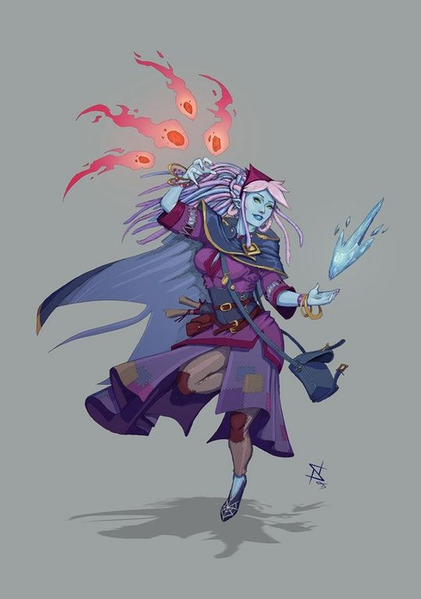
Arveene Amblecrown
Water Genasi
New member of the Flatcoat Circus joined while Wyrin left.
Was holding a Blue Wild Magic Orb that was given to the party.

Slide 12
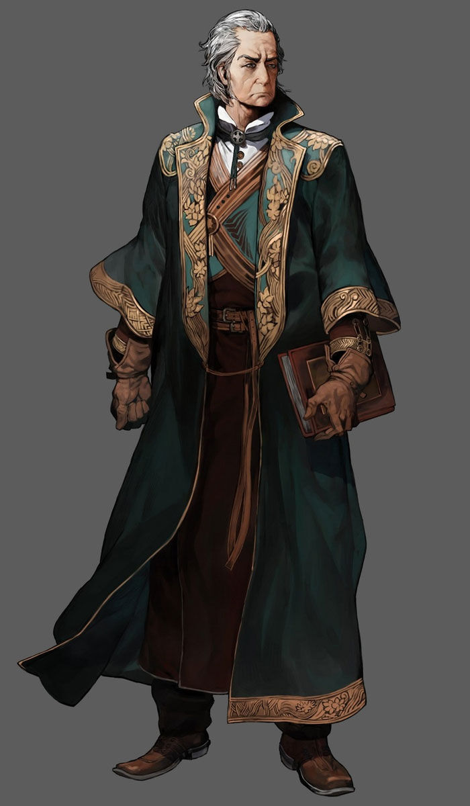
Ostaram Dashkev
Human
The Governor of Basinhold.

Slide 13
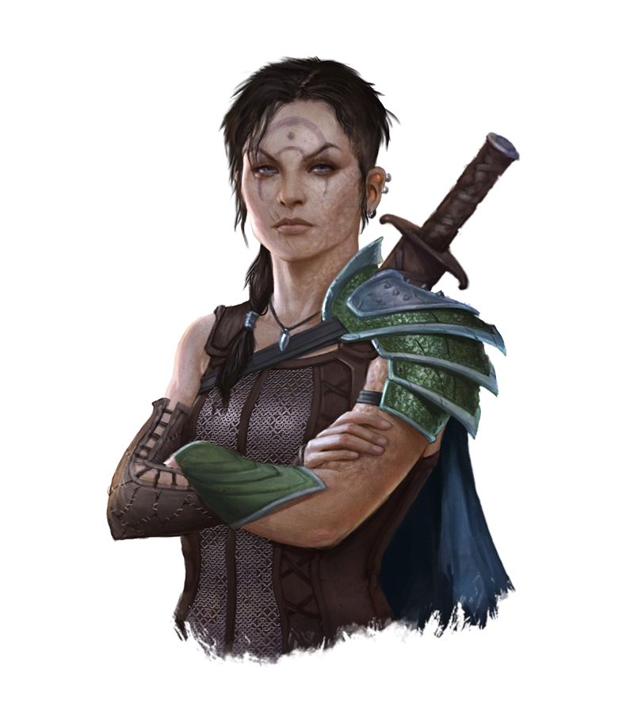
Akna Firahel
Half Elf
Head Guard of the Basinhold Prison.

Slide 14
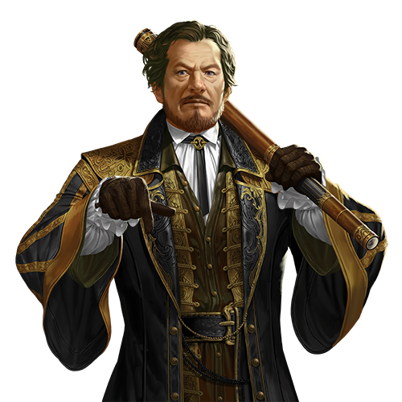
Colin Tallstag
Half Elf
The Lawmaker of Basinhold.
Good friends with the party and thankful for them saving their life
Is a bro

Slide 15
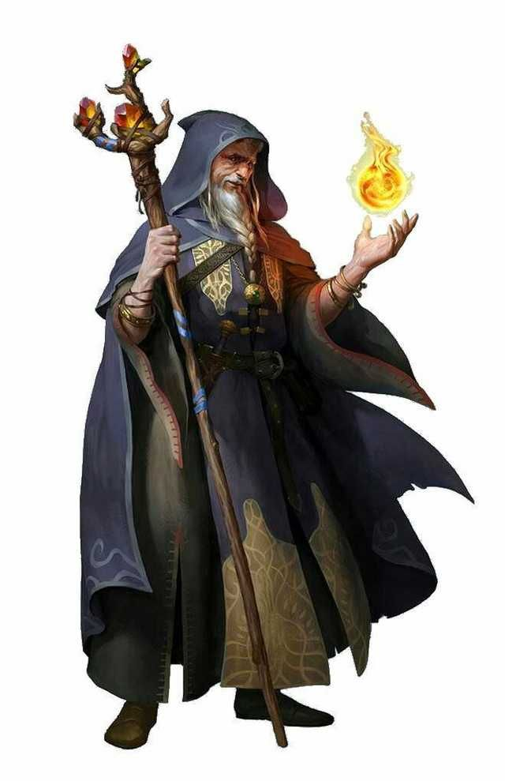
Thervan Hanali
Half Elf
The Owner of the Sweet Pond Magical Market
One of few who have great knowledge of Elementals outside the clerics who live in Wifcaster

Slide 16
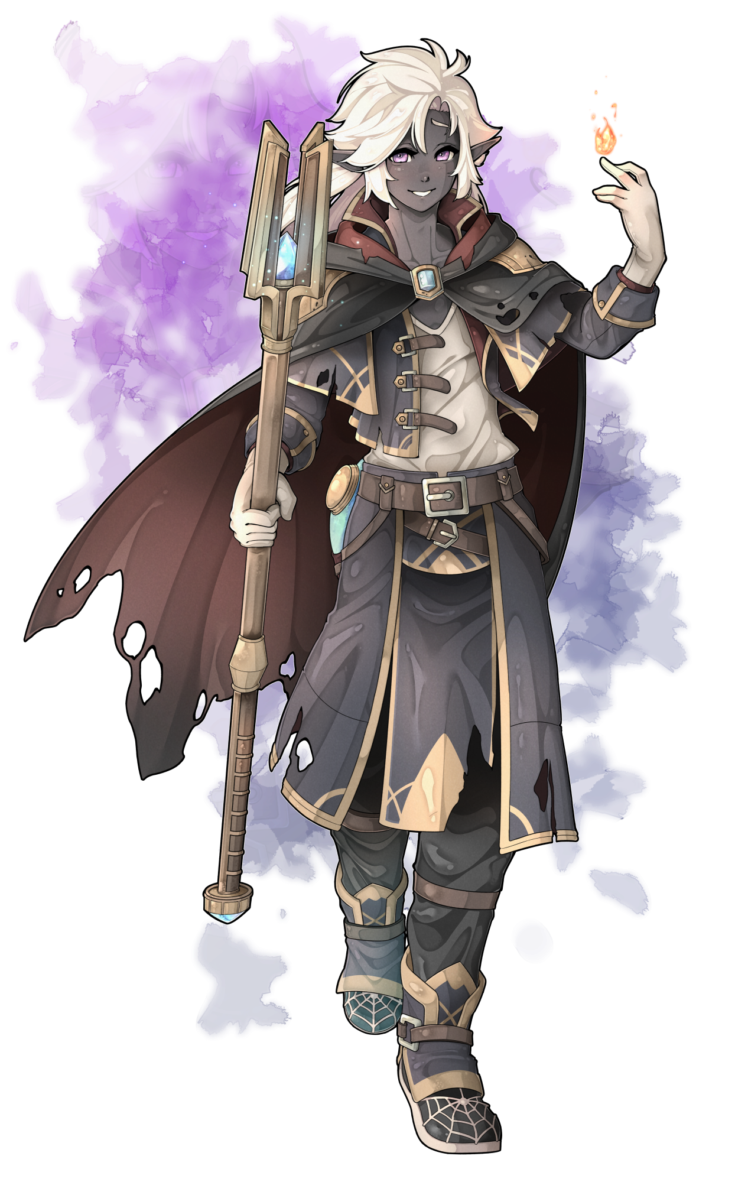
Tanzim Hanali
Half Elf (More Drow)
The Son of the Owner of the Sweet Pond Magical Market.
Very happy and the number one fan of the Order of the Orb.

Slide 17
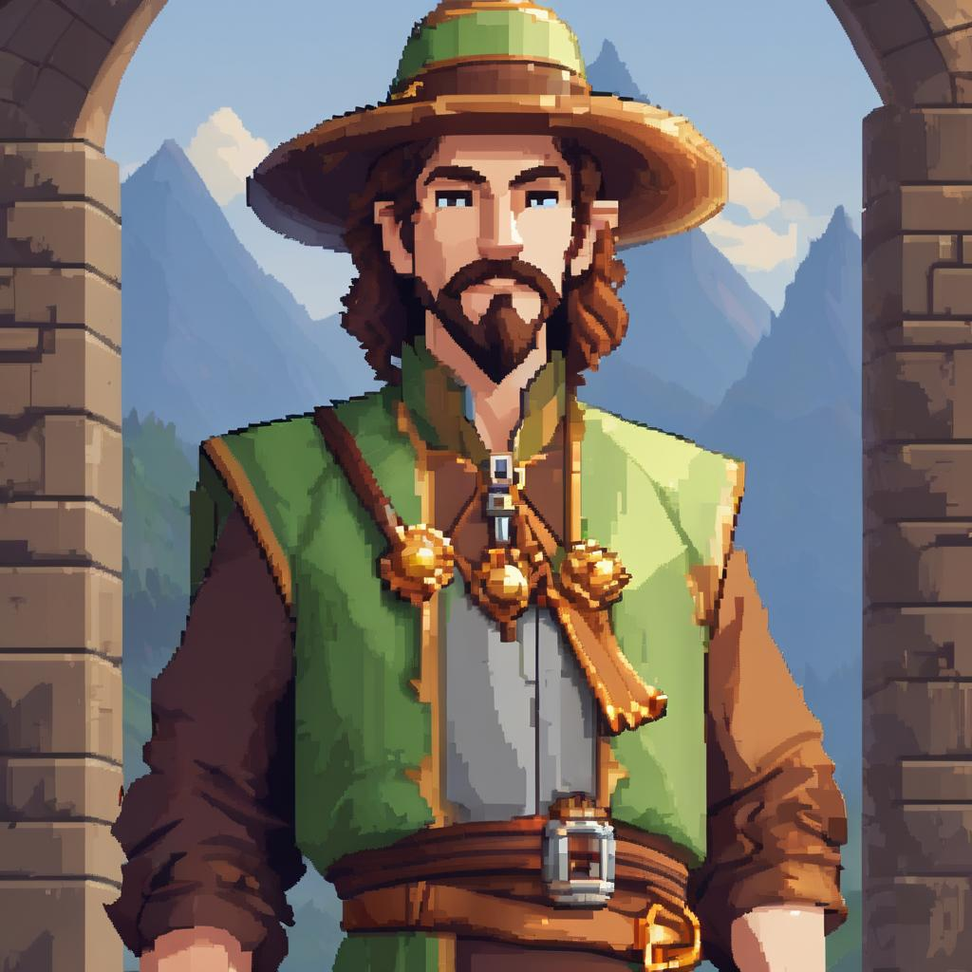
Finjin
Human
The owner of the wonderful Finjins Magic Shop.
Has the party wearing his merch around town to boost popularity.

Slide 18
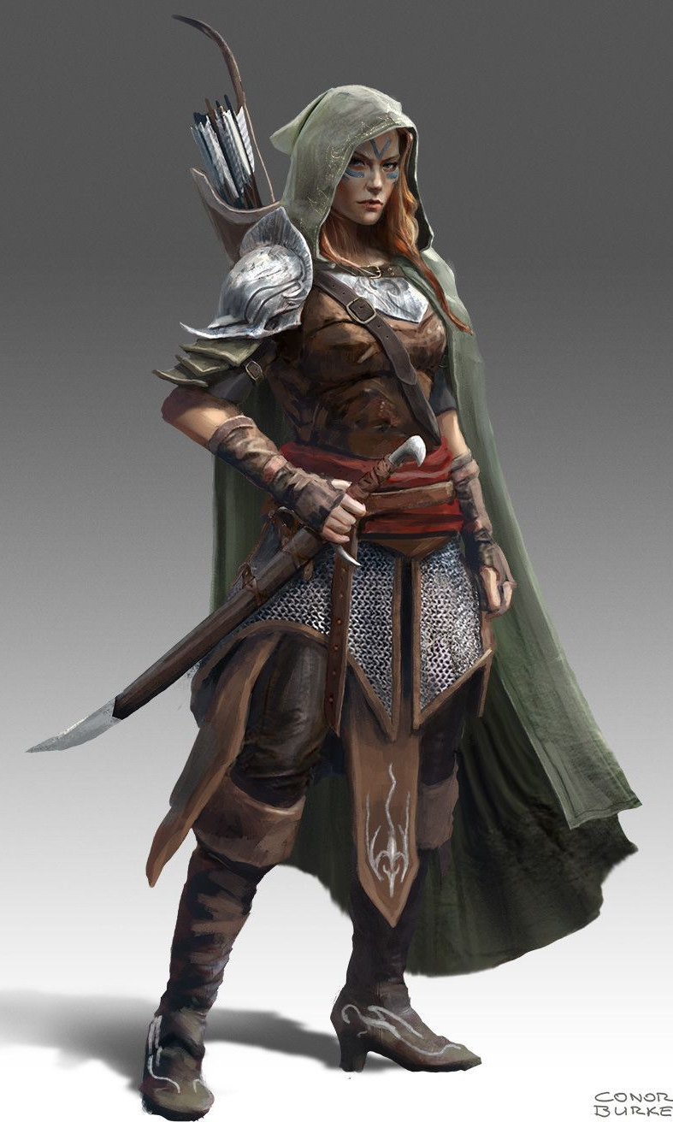
Viper “The Hidden Fang”
Wood Elf
The leader of the Laughing Knives
Helped the party with Wolfe
Considers the party as members of the clan
Gave Bellum the mark of their clan

Slide 19
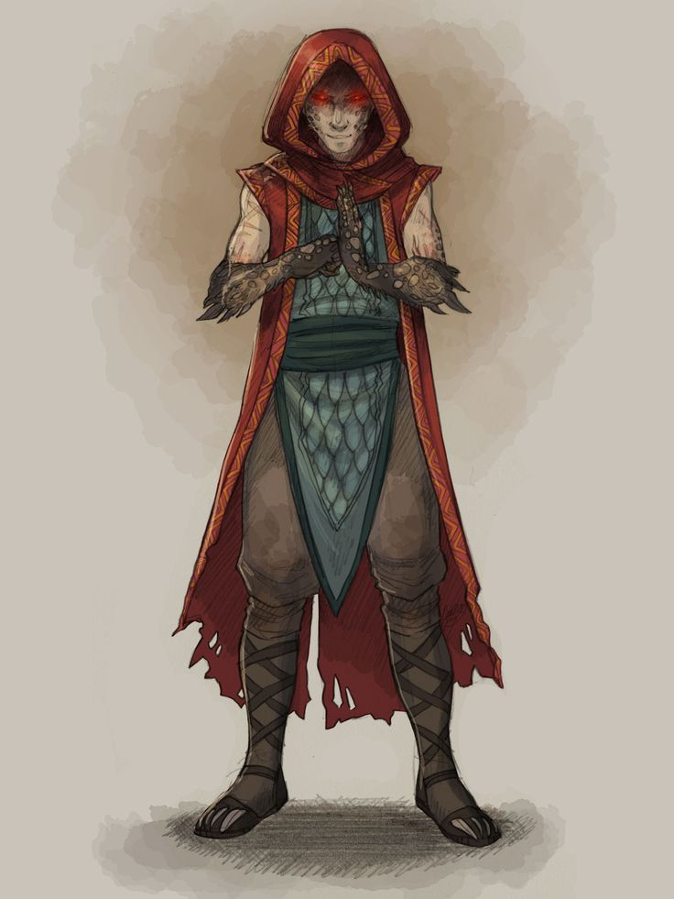
Casey
Yuan-Ti
The second in command of the Laughing Knives
Helped the party with the secret temple of Zehir
Became slightly controlled by an unknown Entity, once they entered the temples main worship room

Slide 20
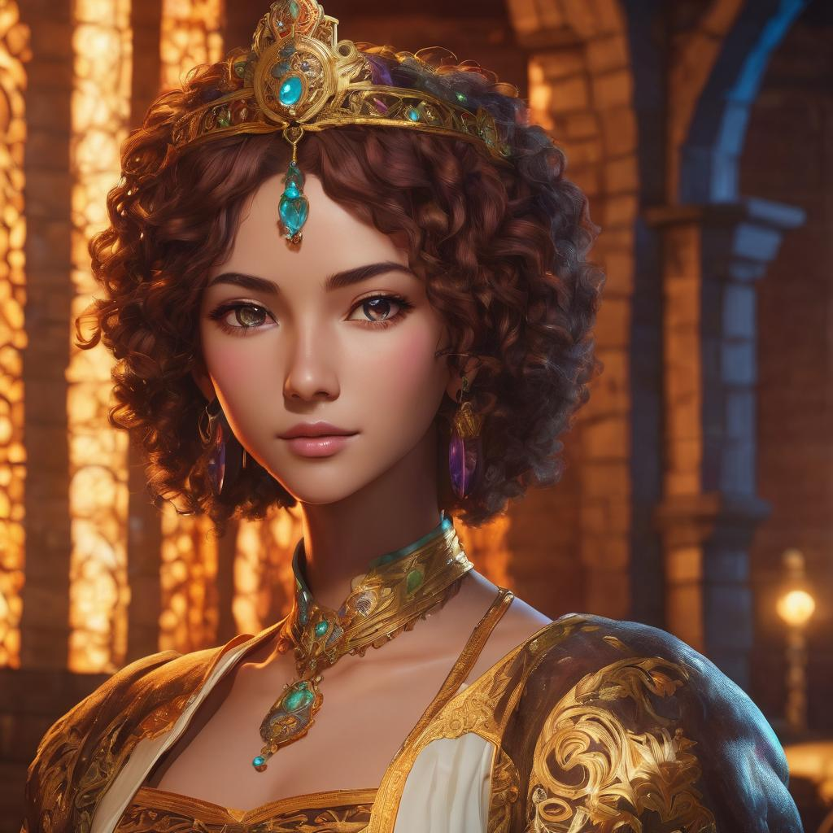
Elizabeth Qrand
High Elf
The sorcerous queen of Qrand.
Her husband died by attempting to reach the power of Hadaar, by means of a spell scroll of Contact Other Plane.

Slide 21
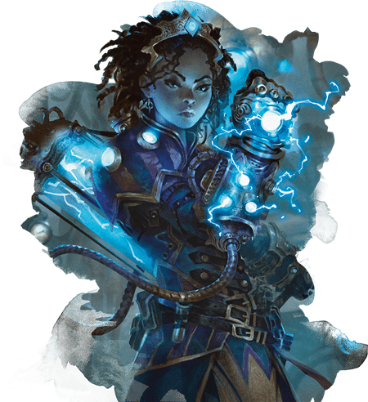
Ellis Qrand
High Elf
The princess of Qrand
Is friends with the queen of Shesmont, Kera, and grew up with her together
Using her innate smarts and magical background she is a strong Artificer and helps the party with any magical mechanic needs

Slide 22
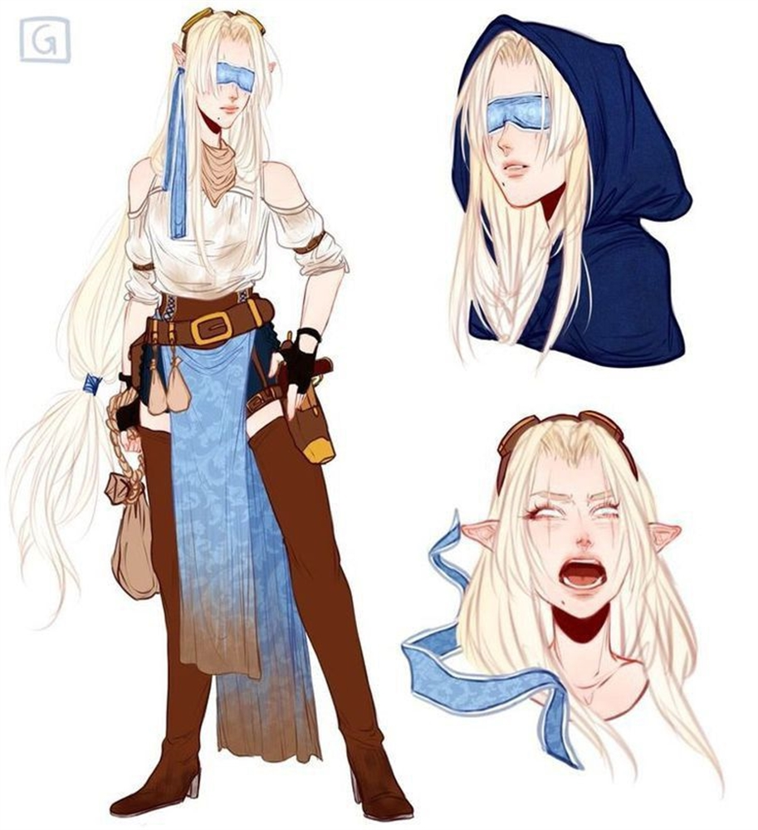
Kera Shereen
High Elf
The queen of Shesmont
Was using Hadaar to protect her people but changed after being possessed and trying to kill the party.
Best friends with Princess of Qrand Ellis
Plan to be Wed to Camus sometime in the future

Slide 23
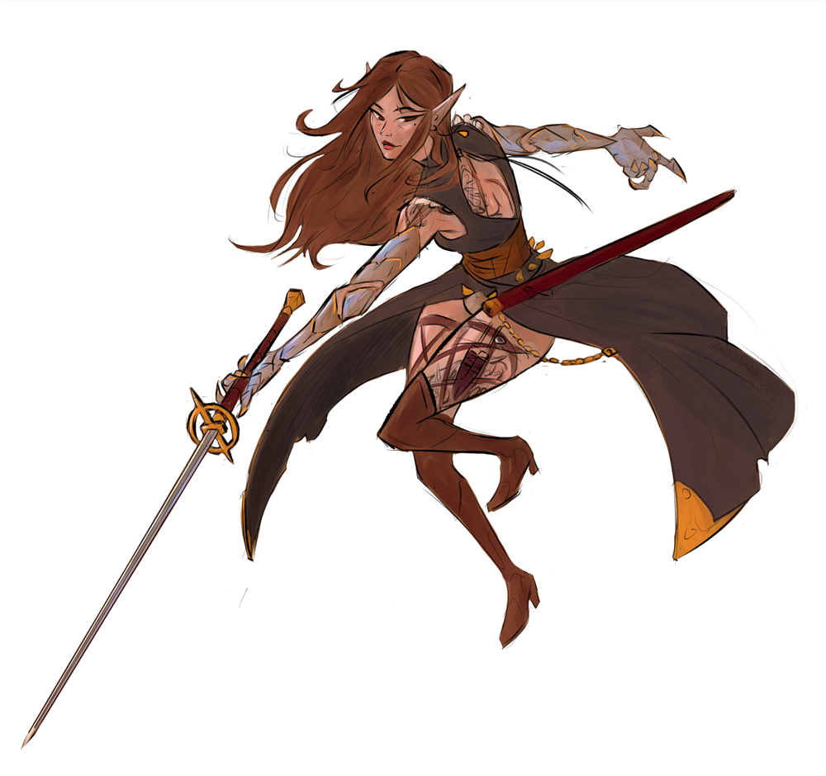
Ildra Duskdancer
Human
The military and royal guard commander of Shesmont.
Best friends with Camus and Kera.

Slide 24
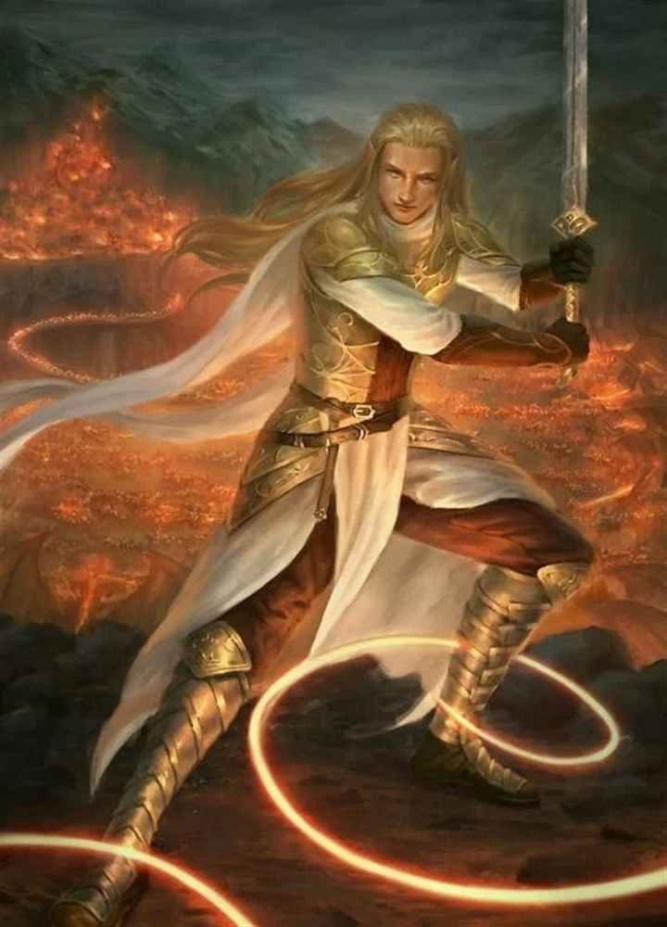
Camus Krisrieth
High Elf
The soon to be king of Shesmont

Slide 25
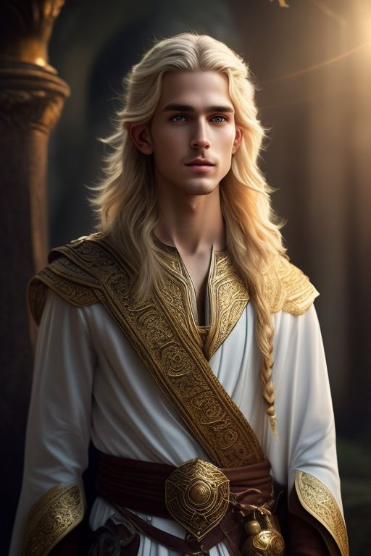
Ralnor Beifiel
Half Elf
An intern initially shadowing a lawmaker to become one himself
Now a big advocate for the Cerulean Resistance and dedicating himself to becoming more magically knowledgeable for the team.

